Slide 1
Business Economics
Marcelo Ortiz M.

Slide 2
Topic 5: Decision Rights and Multiple Tasks
Objectives:
1) Explain the trade-off of specialization in task assignments
2) Identify the types of firm growth and the factor that determine them
3) Identify Matrix, Mixed, and Network organizations

Slide 3
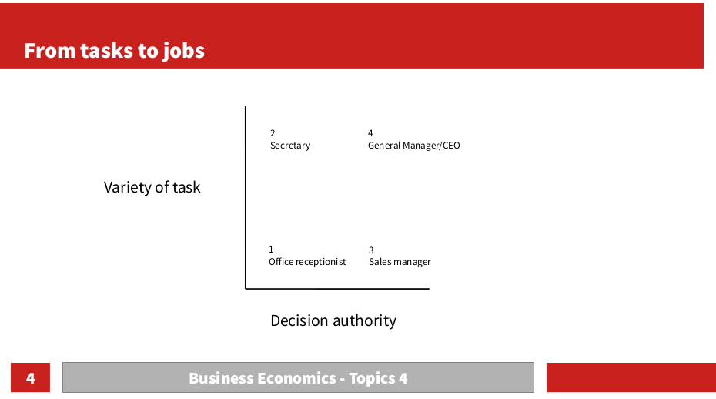
Bundling tasks into jobs
So far, we have discussed one of the dimensions of a job: decision authority
We move now to the second dimension: the variety of tasks
When bundling tasks into jobs, there are two options
  Specialized task assignment
  Broad task assignment

Slide 4
Bundling tasks into jobs
Example:
  Taylor Inc is a financial consultancy company, specialized in international taxation and ESG.
  Let’s consider just two functions that have to be done in the company:
    1) Selling consultancy services
    2) Providing consultancy services
  Notice that these functions can be partitioned into multiple small tasks
    1) Selling: finding new clients, contact them, visit them and present services, closing contracts.
    2) Providing the service: meetings to understand the situation, prepare solutions, present solutions
  For simplicity, we should ignore the small tasks for now.

Slide 5
Bundling tasks into jobs
Example:
  How can Taylor Inc. bundle the tasks into jobs?
    At least 4 options make sense, let’s see why
    1 job (no specialization)
    2 jobs ( Sales and Service)
    2 jobs ( ESG. and Taxation)
    4 jobs (fully specialized)
 | Sale | Service
Taxation | Task 1 | Task 2
ESG | Task 3 | Task 4

Slide 6
Bundling tasks into jobs
Cost and Benefit of Specialized Task assignments
Benefits | Costs
- Comparative advantage - Economies of scale - No need for cross-training expenses | - Forgone complementarities (selling and product-design in tailored products; 2 related steps in an assembly line: audio system and speakers) - Coordination costs (regular meetings+new orders; exceptions handling, information systems) - Functional Myopia (decisions are not considering the big picture: selling products than will not fulfill client’s requirements) - Reduced flexibility (what if the specialized worker is sick or on vacation?

Slide 7
Bundling tasks into jobs
Example 1: analyze the benefits/costs for the specialized task assignment in Taylor Inc.
  When fully specialization is better?
Example 2: repeat the same analysis for a Bank:
  Tasks: lending and selling insurances
  Clients: individuals and corporations

Slide 8
Bundling of Jobs into Subunits
Managers are confronted with a similar economic problem (“trade-off) when assigning jobs to business units, subsidiaries, departments.
  Groups/subunits lower communication/coordination costs within the group
  However, managers must coordinate across groups
How to group?
  1) by function (Apple)
  2) by product-type or geography (Aena)
  3) there are more options!

Slide 9
Grouping by Function
The idea here is to group jobs into a functional specialty: sales, finance, R&D, operations.
In the case of Taylor Inc.:
CEO
Procedures for:
(1)information flow
(2)handling special cases
Sales Dep.
Service Dep.

Slide 10
Trade-offs of grouping by function
Benefits | Costs
- Effective coordination within areas - Generation of functional expertise - Clear promotion path - Economies of scale | - Opportunity cost of the time/resources spent in coordination across areas - Lack of focus on the big picture: clients, operative solutions - Less effective use of product or geographic information

Slide 11
Grouping by Product-type or Geography
Mostly known as multidivisional form
The jobs are grouped into business units based on products or locations
Strategic decisions: organizational design, allocation of capital, divisions creation/closure
CEO
Operative decisions: visiting clients, pricing, consultancy
Each Division has its Sales and Service Dep.
Taxation Div.
ESG Div,

Slide 12
Trade-offs of grouping by product or geography
Benefits | Costs
- Decisions rights for operation are located where the relevant knowledge is. - Lower coordination cost across departments within a division - Senior management focuses on the overall performance and main strategy | - units optimization might not be equivalent to the firm’s value optimization (interdependencies and synergies: shared resources and units competition) -Splitting personnel of the same department makes more difficult to transfer new knowledge.

Slide 13
Where functional units work best?
Small companies (although there are exemptions for this rule: Apple)
Homogeneous products and markets
Slow rate of innovation in the industry

Slide 14
How to get the best of both systems?
Matrix Organizations: functional departments but the employees from the departments are assigned to units (products, geography, specific projects)
  Double reporting: functional manager and product manager
  Departments (functional unit) serve to develop field knowledge and career, as well as to evaluate performance (specific knowledge from the unit + comments of product manager)
Example: In the case of hospitals, indicate the product/services and functional units.
Example 2: In the case of construction companies, indicate the product/services and functional units.

Slide 15
How to get the best of both systems?
Matrix Organizations enable employees to focus on the overall business unit, keeping functional supervision in place
Problems
  1) intersection of authority lines (solution: compensation scheme)
  2) higher influence cost
  3) complex management can delay decision making

Slide 16
Mixed and Network organizations
Mixed: firms use more than one method to organize subunits: some of them use functional design whereas others use product grouping
  Ex. Banks and “premium banking” using cross-trained executives for selling multiple products to sophisticated clients. At the same time, for regular clients, the banks have an executive that redirect cases to different areas in cases needed (loans, mortgages, Mutual funds,...)
Network: division based on function/geography/product and work-groups act (or are) as independent organizations with no formal lines of authority.
  Ex. Keiretsu.

Slide 17
Summary
Main concepts:
Task → jobs
Specialization vs broad task assignment
Centralization vs decentralization
Jobs → units
Assignment by functionality or product/geography
Matrix and Network designs

Slide 18
Cases to Discuss
Identify a bank/consultancy/manufacturer in Spain.
Read annual reports and news. Identify their organizational structure and provide an explanation and comparison.
10 min, 7-11 slides.

